Slide 1
MSAI 699 CAPSTONE | WEEK 7
Explainable AI Email Triage
A research prototype evaluated for urgent-message prioritization Keith G. Broussard | Summer 2026
Notes:
Timing: 0:00-0:17
This project examines whether a transparent machine-learning system can help people identify urgent email without creating unacceptable risk. I will explain the problem, how I evaluated the model, what testing revealed, and why the software is ready to demonstrate even though the model still requires revision.
[Sources]
- README.md
- docs/project_review_guide.md

Slide 2
The goal is prioritization—not autonomous decision-making
Operational need
Important messages can be buried in a high-volume inbox. A useful triage tool should surface urgent items consistently and explain what influenced each score.
Risk boundary
False negatives can hide urgent work. False positives create review burden. The system therefore remains decision support with human review—not an automatic routing authority.
INPUT
MODEL SUPPORT
HUMAN CONTROL
Incoming email
Score + explanation
Human decision
A message enters the local workflow for review.
The model ranks urgency and shows influential terms.
A person reviews the evidence and decides what action is appropriate.
2
Notes:
Timing: 0:17-0:47
The operational need is straightforward. Urgent messages can be missed when people must sort a high-volume inbox manually. The model is intended to prioritize review, not replace judgment or take action on email. Both error directions matter. A false negative can hide urgent work, while a false positive adds review burden and can reduce trust in the tool. For that reason, explanations and human oversight are part of the design boundary. Every score remains a recommendation for review, not an automatic routing decision.
[Sources]
- README.md
- docs/decisions.md
- docs/week6_experiment_record.md

Slide 3
A small reviewed sample defines the evidence boundary
Evidence scope
Source records were filtered and manually reviewed before modeling.
517,401
199
30
Source records in the Kaggle Enron distribution.
Reviewed labeled messages used for this capstone evaluation.
Urgent messages; the remaining 169 were nonurgent.
3
Notes:
Timing: 0:47-1:32
The source collection contains 517,401 Enron email records, but the modeling evidence is intentionally much narrower. I used 199 manually reviewed messages: 169 nonurgent and 30 urgent. A fixed stratified split placed 159 messages in training and 40 in a preliminary holdout. Urgency-enriched sampling supplied enough positive examples for the research exercise, so the labeled class share is not an estimate of a normal mailbox. The sample supports controlled experimentation, but not broad operational reliability. Raw message content and reviewer notes remain excluded from the repository, and demographic fairness was not tested because protected demographic fields were unavailable.
[Sources]
- data/labels/enron_urgency_labels_v1.csv
- results/metrics/week6_reproducibility.json
- docs/week6_experiment_record.md

Slide 4
The project advanced through controlled evidence checkpoints
BASELINE
OPTIMIZE + EXPLAIN
TEST + DECIDE
Establish
Build a reproducible TF–IDF and logistic-regression reference model.
Improve
Tune on training data, inspect explanations, and preserve the fixed split.
Challenge
Use nested cross-validation, threshold tests, error analysis, and a recorded decision.
4
Notes:
Timing: 1:32-2:15
The project advanced through controlled checkpoints. The Week 3 baseline established a reproducible TF-IDF and logistic-regression reference model. Week 4 tested 24 class-balanced configurations using five-fold cross-validation and added global and case-level SHAP explanations. Week 6 separated threshold selection from evaluation through nested cross-validation, then froze the decision before the preliminary holdout comparison. Week 7 added a separate readiness framework. Gate A tests whether the software can support a safe local demonstration. Gate B tests predictive reliability. This separation prevents a functioning interface from being treated as proof that the classifier is reliable.
[Sources]
- notebooks/baseline_model.ipynb
- notebooks/week4_model_optimization.ipynb
- notebooks/week6_testing_debugging.ipynb
- docs/week7_conditional_advancement_gates.md

Slide 5
Optimization improved training evidence—but not the holdout result
Training-data comparison
Mean cross-validated urgent F1 increased from 6.7% to 11.4%.
+4.7 pts
2× recall
−29%
Mean cross-validated urgent F1 increased from 6.7% to 11.4%.
Mean cross-validated urgent recall increased from 4.0% to 8.0%.
TF–IDF features decreased from 4,097 to 2,895.
5
Notes:
Timing: 2:15-2:57
I tested 24 class-balanced configurations and selected the strongest training candidate. Its mean cross-validated urgent F1 increased from 6.7 to 11.4 percent, and urgent recall doubled from 4 to 8 percent. The feature space also decreased from 4,097 to 2,895 features. However, the preliminary holdout result did not improve. Urgent F1 remained 44.4 percent, with four false negatives and one false positive. The optimization made the model smaller and improved the training evidence, but it did not establish generalization. The complete selected configuration is documented in the repository.
[Sources]
- notebooks/week4_model_optimization.ipynb
- results/metrics/week4_cv_summary.csv
- results/metrics/week4_model_comparison.csv
- docs/week4_experiment_record.md

Slide 6
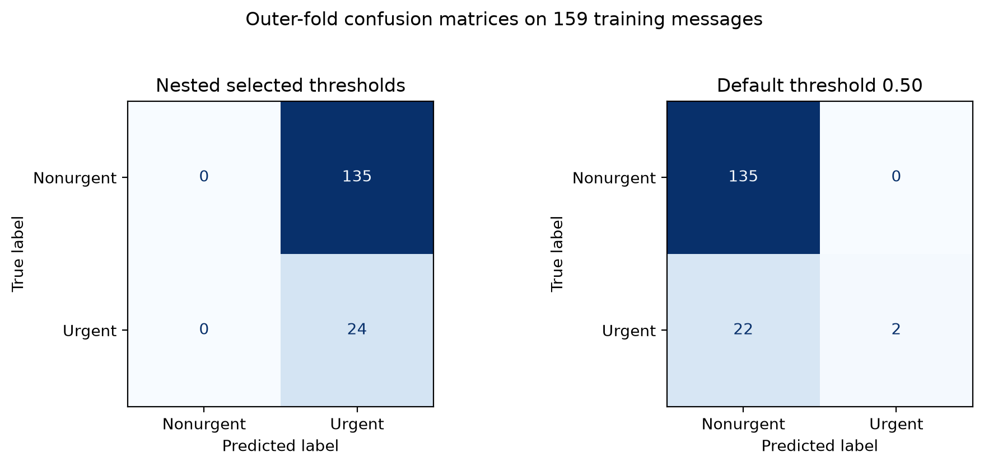
Threshold testing exposed the reliability problem
Threshold testing exposed the reliability problem
0.45 threshold
100% urgent recall 26.2% urgent F1 135 false positives
Every training message was labeled urgent.
0.50 threshold
8.3% urgent recall 15.4% urgent F1 22 false negatives
6
Notes:
Timing: 2:57-3:49
Week 6 threshold testing exposed the central reliability problem. At 0.45, urgent recall reached 100 percent, but only because every one of the 159 training messages was labeled urgent. That created 135 false positives and reduced triage to reviewing everything. At 0.50, the model produced no false positives in the outer-fold predictions, but it found only 2 of 24 urgent messages. Recall fell to 8.3 percent, with 22 false negatives. The probability scores were also highly compressed: 157 of 159 out-of-fold probabilities fell from 0.45 to below 0.50. A small threshold change therefore flips nearly the entire workload. Neither operating point balances urgent-message detection with a manageable review burden, so changing the threshold alone does not solve the problem.
[Sources]
- notebooks/week6_testing_debugging.ipynb
- results/metrics/week6_threshold_analysis.csv
- results/metrics/week6_outer_predictions.csv
- results/figures/week6_confusion_matrices.png
- docs/week6_experiment_record.md

Slide 7
DISPOSITION
The demo passed; the model still needs revision
Controlled local demo passed
Model disposition: revise
Human review required
No shadow or production approval
Notes:
Timing: 3:49-4:40
The evidence supports two different conclusions. First, Gate A passed. All 13 automated tests passed, and the validator completed 60 deterministic synthetic inference runs while checking visible thresholds, bounded explanations, privacy-safe output, input validation, human-review status, and safe failure when the local model was unavailable. Second, the predictive disposition remains revise because Gate B failed. The working FastAPI demonstration shows that the research workflow can be presented repeatably. It does not establish predictive reliability, authorize shadow testing, or approve production deployment. No automated email action is permitted, and the locally generated model artifact remains excluded from Git.
[Sources]
- docs/week7_automated_test_report.md
- results/metrics/week7_demo_validation.json
- results/metrics/week7_readiness_gate_evaluation.csv
- docs/week7_readiness_evaluation.md

Slide 8
Next steps should establish reliable evidence before deployment
EXPAND
DIAGNOSE
RETEST
More reviewed data
Increase urgent examples and preserve a truly untouched final test set.
Better separation
Review probability calibration, feature behavior, and common failure patterns.
Same controls
Repeat nested evaluation, privacy checks, and a formal human approval gate.
8
Notes:
Timing: 4:40-5:08
The next work should improve the evidence, not expand deployment claims. Increase the reviewed sample, preserve a truly untouched final test set, and investigate calibration, vocabulary coverage, and the failure patterns behind both error types. Then repeat the controlled evaluation under the same privacy, reproducibility, workload, and human-approval gates. The software workflow is ready to demonstrate, while the classifier still needs better evidence before any operational recommendation.
[Sources]
- docs/project_review_guide.md
- docs/week7_conditional_advancement_gates.md
- docs/week7_demo_runbook.md

Slide 9
PROJECT ACCESS
Repository
and contact
https://github.com/kbroussard34749/
explainable-ai-email-triage
kbroussard34749@ucumberlands.edu
Notes:
Timing: 5:08-5:36
The project repository is shown on this slide. It contains the code, executed notebooks, test results, decision records, and reproducibility guidance. I can be reached at the university email shown. Thank you.
[Sources]
- https://github.com/kbroussard34749/explainable-ai-email-triage

